Slide 1
Introduction to ROAR High Performance Computing (HPC) System: Applications in Academic Research using R
Nitheesha Nakka
C-SoDA Brownbag Spring 2023

Slide 2

Background: What is an HPC
High Performance Computing (HPC) System
Supercomputer that Compute complex calculations and process large datasets
ROAR = Penn State’s Supercomputer
High performance research cloud
RISE — Research Innovations with Scientists and Engineers
Goals
Interface with HPC
Submit a Job
Operating FileZilla
Writing a PBS script

Slide 3
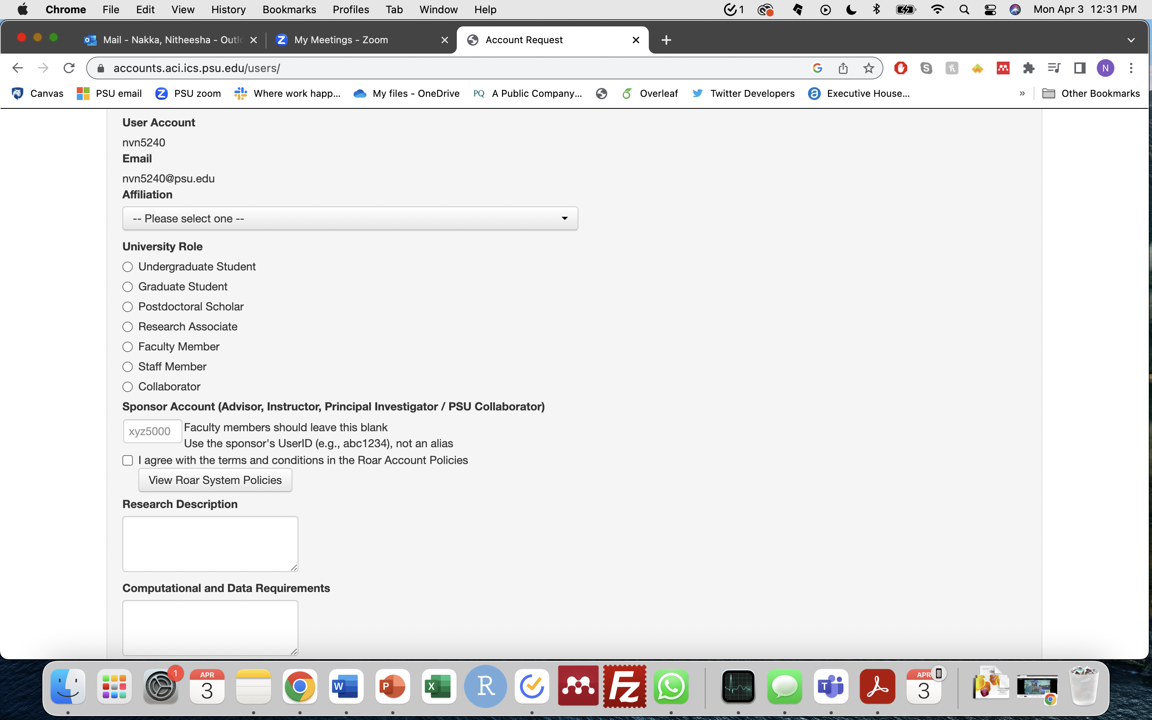
Getting Started
Account Setup
Request an Account:
https://www.icds.psu.edu/computing-services/account-setup/
Submits a ticket to I-ASK
All Non-faculty need a “sponsor” for a ROAR account
Advisor or Course Instructor
Resource: https://www.icds.psu.edu/computing-services/roar-user-guide/getting-an-account-penn-state-faculty-staff-and-students/
Notes:
PI will be emailed

Slide 4
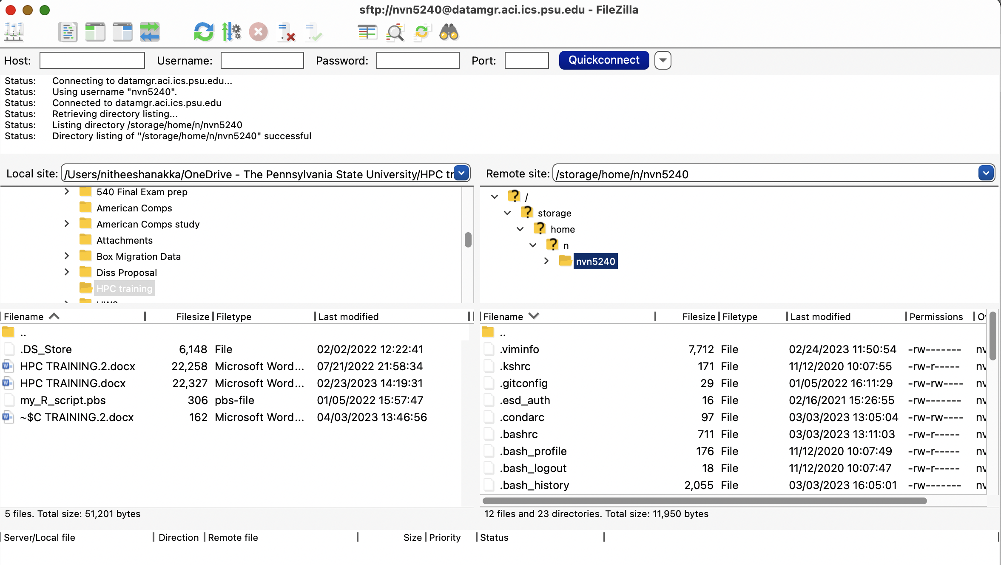
Getting Started
FileZilla Client
Submit jobs and shift files through FileZilla
Operates like a gateway
Download here: https://filezilla-project.org/
Other: command line, WinSCP Secure Protocol Client
Download here: https://winscp.net/eng/download.php

Slide 5
Submitting a Job Step 0: Prepare Scripts
Prepare R script
Prepare PBS script: tells HPC what you need to complete job
#!/bin/bash -l
#PBS -N example
#PBS -l walltime=1:00:00
#PBS -l nodes=1:ppn=1
#PBS -l pmem=10gb
#PBS -j oe
#PBS -A open
#PBS -m abe nvn5240@psu.edu
# Go to the submission directory, making the folder that the pbs is in as the working dir
cd $PBS_O_WORKDIR
# Run the job itself
#R --file= /storage/home/...
R CMD BATCH example.R
Resource: https://www.icds.psu.edu/computing-services/roar-user-guide/how-to-assess-which-resources-you-should-request/

Slide 6

Submitting a Job Step 0: Prepare Scripts
#!/bin/bash -l
#PBS -N example → What I want to call the job
#PBS -l walltime=1:00:00 → length of time requested for job (48 hours max in ”open”)
#PBS -l nodes=1:ppn=1
→ nodes = the number of computers
→ ppn = the number of processors per node
Node (1 machine)
Cluster
processor

Slide 7
Submitting a Job Step 0: Prepare Scripts
#!/bin/bash -l
#PBS -N example → What I want to call the job
#PBS -l walltime=1:00:00 → length of time requested for job
#PBS -l nodes=1:ppn=1
#PBS -l pmem=10gb → max memory per processor
#PBS -j oe → code output and error output should be in same file
#PBS -A open→ allocation (also known as “queue”)
#PBS -m abe nvn5240@psu.edu → emails you updates about job
# Go to the submission directory, making the folder that the pbs is in as the working dir
cd $PBS_O_WORKDIR
# Run the job itself
#R --file= /storage/home/...
R CMD BATCH example.R → run script and save output to a file
MAKE SURE R script and PBS script have SAME NAME!!

Slide 8
Submitting a Job Step 1: Login
Open Terminal
Mac- Search “terminal”
PC- search “command prompt”
Mac: Type- ssh nvn5240@submit.aci.ics.psu.edu (save this)
-> Type- Password
-> Type- 1 – Duo Push Authentication
Windows: PuTTy to access SSH Client
https://www.icds.psu.edu/computing-services/getting-started/
Install: https://www.putty.org/
Arrive in Home Directory
Other storage directories that “live” here
work: quota limit = 128 GB
home: quota limit = 10GB
Scratch: 1 million file capacity but ITEMS DELETED IN 30 DAYS

Slide 9
Step 1a: Lets Look Around
Basic Bash Commands
pwd = print working directory path
ls = lists whats in a folder
ls -al= shows you when file is last modified
ls -a = shows all hidden files too
cd [directory name] = change directory
Can also combine directory paths
cd .. = moving one directory “up”
cd ~ = move all the way back to home directory
mkdir [new directory name] = make directory
cat [file name] = look at script contents
rm [file name] = remove a file , rm –r [directory name] = remove directory
R = start R shell
q() = quits session
python = start Python shell
exit() = quits session
Resource: https://www.earthdatascience.org/courses/intro-to-earth-data-science/open-reproducible-science/bash/bash-commands-to-manage-directories-files/

Slide 10
Submitting a Job Step 2: Transfer Files through FileZilla
2a) First Login to FileZilla
username= nvn5240
password =
Port = 22
Host = datamgr.aci.ics.psu.edu
After doing the above 1 time you can click “quick connect” to go directly to home directory
2-Factor authentication every login
2b) Drag & Drop
Local → Remote
Can also delete files/ folders in filezilla
Note: Whatever changes you make either in local or remote DOES NOT automatically make those changes on the “opposite” computer

Slide 11
Submitting a Job Step 3: Submit a Job
PBS File submits the job!
Be in the folder with the script and PBS files are in
qsub [NAME OF PBS FILE]
qsub [Allocation Name] [Name of pbs file]
Step 3a : Check job status
qstat -u nvn5240
q = job is waiting in line, R = running, C = complete
Step 3b : delete a job
qdel [job number]

Slide 12
Installing R Packages
A) Put it in your R script
B) Install in R session in terminal
C) Conda Installer – eg. ”Tidyverse”
1) module use /gpfs/group/RISE/sw7/modules- this is where anaconda lives
2) module load anaconda
3) conda create -n rpkgs (Will not have to do this again for future installs)
this name is in some default location
4) conda activate rpkgs
5) Conda install -c conda-forge r-tidyverse
https://anaconda.org/conda-forge/r-tidyverse

Slide 13
Resources
Programming Help:
https://www.icds.psu.edu/computing-services/roar-training-resources/
ROAR User Guide
https://www.icds.psu.edu/computing-services/roar-user-guide/
ICDS Guidelines
https://www.icds.psu.edu/wp-content/uploads/2020/04/ICDS-ACI-P030-Access-Control-Formatted_v3.1.pdf
Parallelization:
doParallel R package:
https://cran.r-project.org/web/packages/doParallel/vignettes/gettingstartedParallel.pdf
foreach():
https://cran.r-project.org/web/packages/foreach/vignettes/foreach.html
I-Ask Help Desk Virtual Office hours
Myself
Email: nvn5240@psu.edu
Github: https://github.com/NitheeshaN

